Slide 1



Dynamic Trading with Predictable Returns and Transaction Costs.
FE800 – Final Presentation
Advisor – Prof. Majeed Simaan
Course Professor – Prof. Zhenyu Cui
Presented by – Mrinal Gupta, Siddharth Jain, Venkata Bhargava, Varda Matalia

Slide 2
Introduction
BACKGROUND
Traditional portfolio models often ignore transaction costs and return predictability.
Gârleanu & Pedersen (2013) provide a realistic framework for dynamic trading.
Our study implements this model using historical factor and industry return data.
Emphasis on understanding signal decay and trading friction in real markets.
OBJECTIVES
Construct and evaluate a dynamic trading strategy using predictable returns.
Compare performance against equal-weight and static benchmark strategies.
Assess risk-adjusted returns, turnover, and regime-specific outcomes.
Analyze the trade-off between alpha capture and trading costs.
SCOPE AND PARAMETERS
Asset universe: 10 Fama-French industry portfolios (1963–2024).
Predictors: Momentum, Mkt-RF, SMB, HML, RMW, CMA.
Techniques: ElasticNet regression, Ledoit-Wolf shrinkage, rolling window estimation.
Performance metrics: Sharpe ratio, cumulative return, drawdown, turnover.
TIME PERIOD
In-Sample: 1963 – 1996
Out-of-Sample: 1996 – 2024
Regime-based evaluations: Pre-GFC, Post-GFC, Post-COVID, High Rates

Slide 3



Literature Review
Dynamic Portfolio Optimization
Gârleanu & Pedersen (2013): Framework for optimal trading with signals having different decay rates.
Key Ideas: "Aim in front of the target," trade partially toward it.
Application: Implement and evaluate on real-world data focusing on dynamic trading.
Earlier Models & Quantitative Methods
Better at interpreting nuances, socio-economic factors, and managing uncertainty (Bao et al., 2021) Human strategies evolve by integrating behavioral economics insights (Bamber et al., 2010)
Markowitz, RiskMetrics: Lack responsiveness to alpha decay.
ElasticNet (Zou & Hastie, 2005): Manages multicollinearity in predictive signals.
Shrinkage Covariance Estimators (Ledoit & Wolf, 2004): Improves risk estimation under limited data.
Dynamic Trading Frameworks
Explore combining AI's computational speed with human strategic insights (Emami, 2021) Leverage strengths of both AI and human trading for robust financial markets
Almgren & Chriss (2000): Align well with institutional execution strategies.
Our Approach
Need long-term empirical studies comparing AI and human trading impacts Ethical considerations: privacy, market manipulation risks
Develop regulatory frameworks tailored to AI trading risks (Azzutti et al., 2022)
Empirical Financial Data: Build on the foundation using robust Python implementation.

Slide 4



Dynamic Trading with Predictable Returns and Transaction Costs
Goal: Optimize trading strategy using predictability in asset returns while accounting for transaction costs.
Paper: Dynamic Trading with Predictable Returns and Transaction Costs - G & P (2013)
Principle: a) Aim in front of portfolio b) Trade Partially Towards current Aim
Closed form Solution-
1. Trading Rate -
2. Aim Portfolio -
3. Optimal Portfolio -
Core Challenge: Trade-off between exploiting return forecasts and minimizing trading costs.

Slide 5



Continuation.
Portfolio Strategies:
Compare three approaches - Markowitz(Static), Dynamic, Equally weighted(Benchmark)
Markowitz (full rebalancing) -
Net Return:

Slide 6


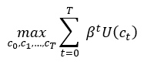
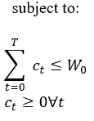


Cake Eating Problem
Problem Formulation
System Dynamics:
Wt: Remaining cake size
ct: Consumption at time t
Objective: Maximize Total Discounted Utility
Dynamic Programming Solution
Bellman Equation:
Optimal Consumption Policies
Finite Horizon (T periods):
Optimal Consumption:
Infinite Horizon (T → ∞):
Simplified Optimal Consumption:

Slide 7
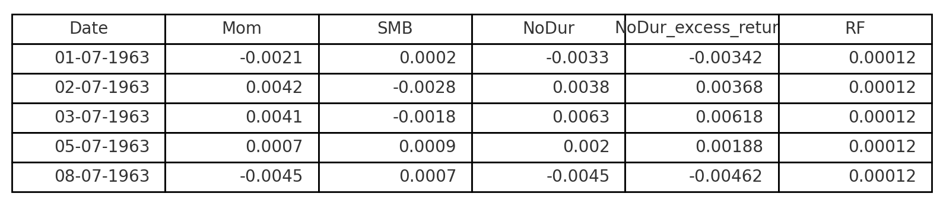
Dataset Overview
Source: 5 Fama-French Factor + Momentum + 10 industry portfolios (1963-2024)
Frequency: Daily → Monthly (resampled to end-of-month)
Added columns: excess returns over risk-free rate
Train-Test Split:
Data split into equal halves
First half: In-sample training and tuning
Second half: Out-of-sample testing of portfolio strategy

Slide 8
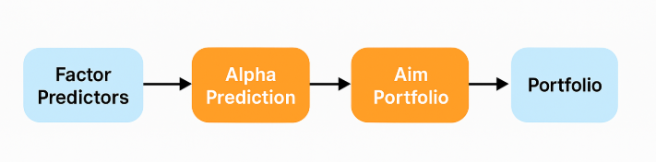
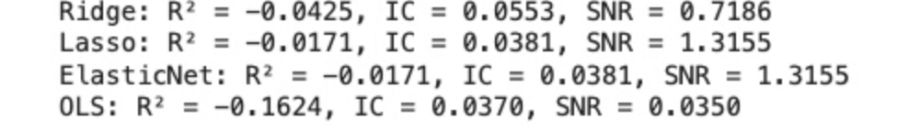
Model Framework
Rolling B Estimation:
Used a 60-month rolling window to regress each industry’s excess return on factor predictors
This helps adapt to evolving relationships between predictors and returns
Regression model: ElasticNetCV (stability + regularization)
Model Comparison:

Slide 9

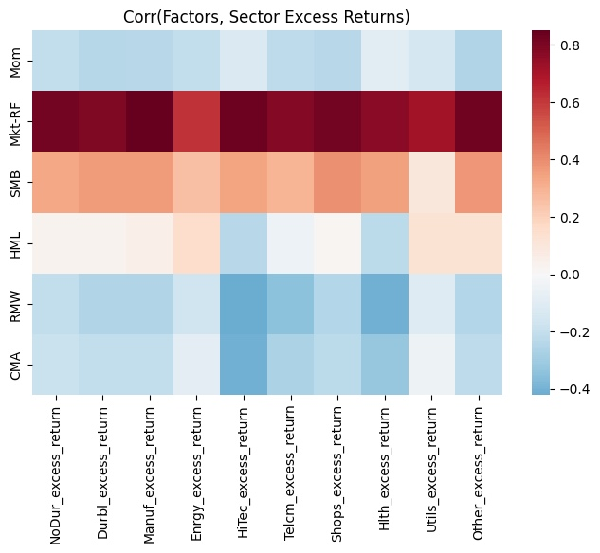
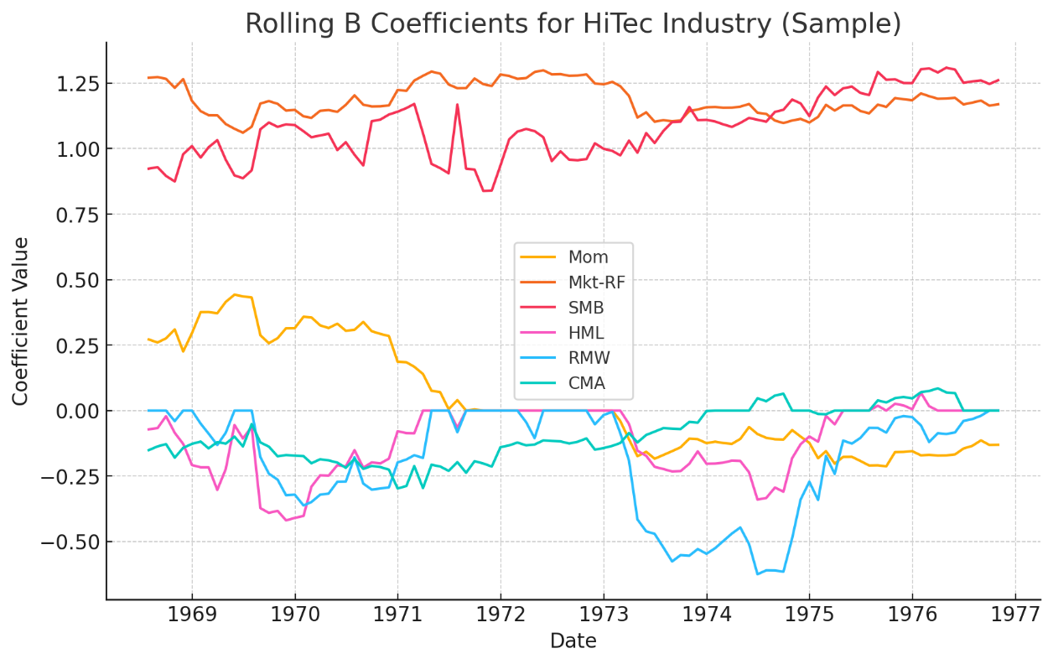
Rolling B Estimation
Estimating B matrix
60-month rolling walk forward window per industry with Multi-task Regression
ElasticNetCV used to stabilize coefficient estimates
Output: factor loading matrix for each month

Slide 10


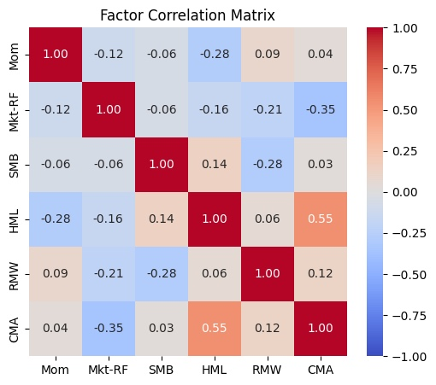
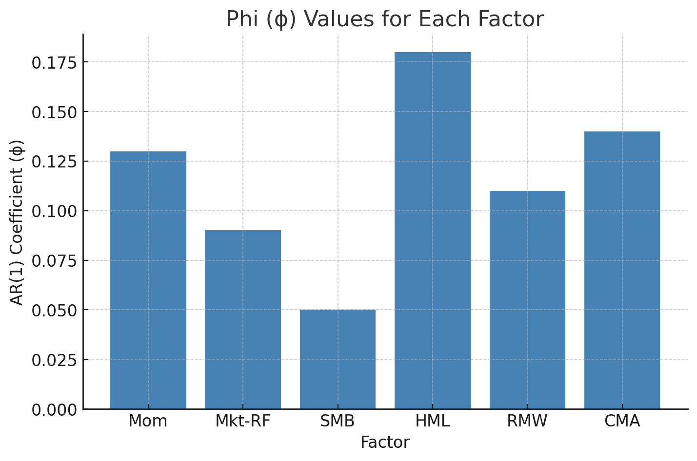
Phi ( ) Estimation
Estimated via VAR(1):
Captures alpha decay rate for each signal
Slower-decaying signals receive more weight in trading decisions

Slide 11
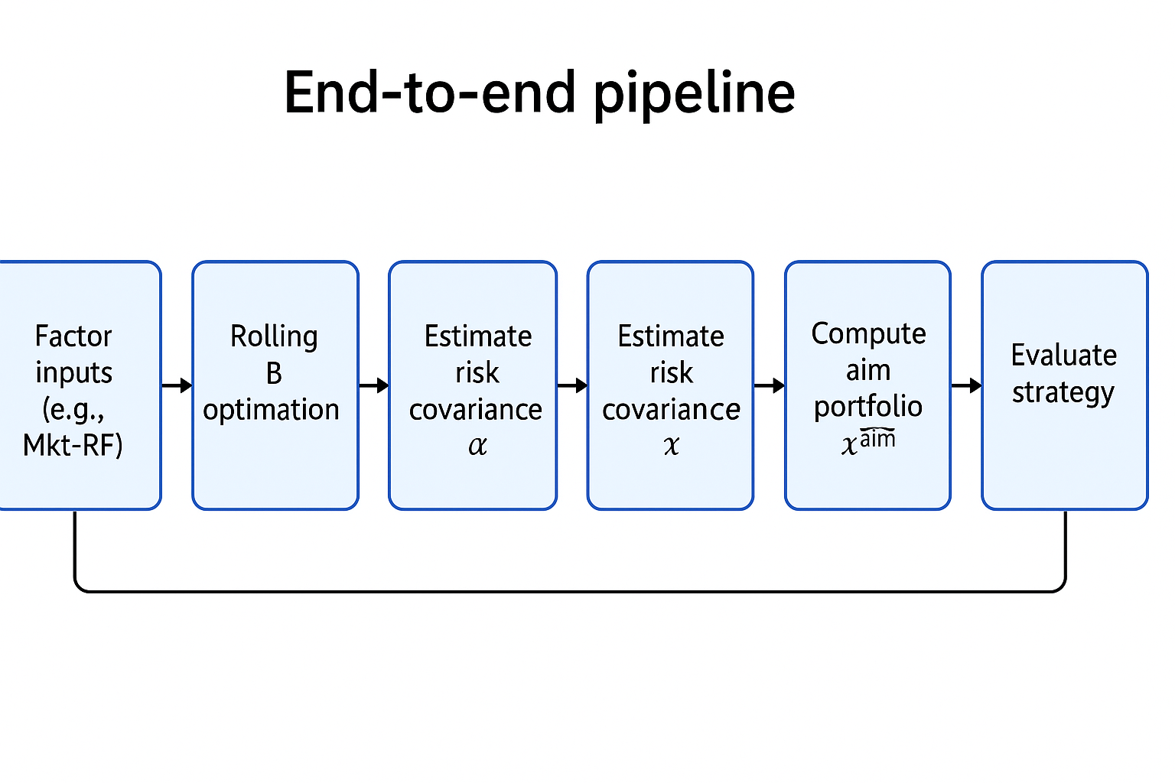
Strategy Mechanics
Each month:
Predict alphas using scaled signals and B
Estimate risk covariance of residual using Ledoit-Wolf method
Compute aim portfolio
Update portfolio using smooth transition matrix
Balances alpha capture and transaction costs

Slide 12
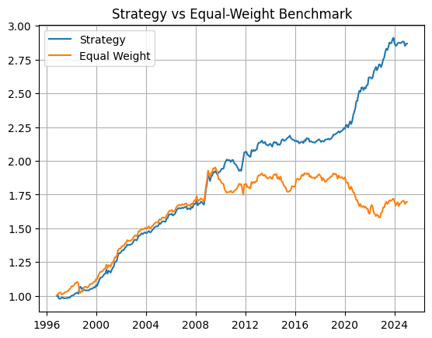
Equal Weight Benchmark Comparison
Compared to naive equal-weight strategy
Our dynamic strategy shows superior cumulative return and risk-adjusted performance

Slide 13
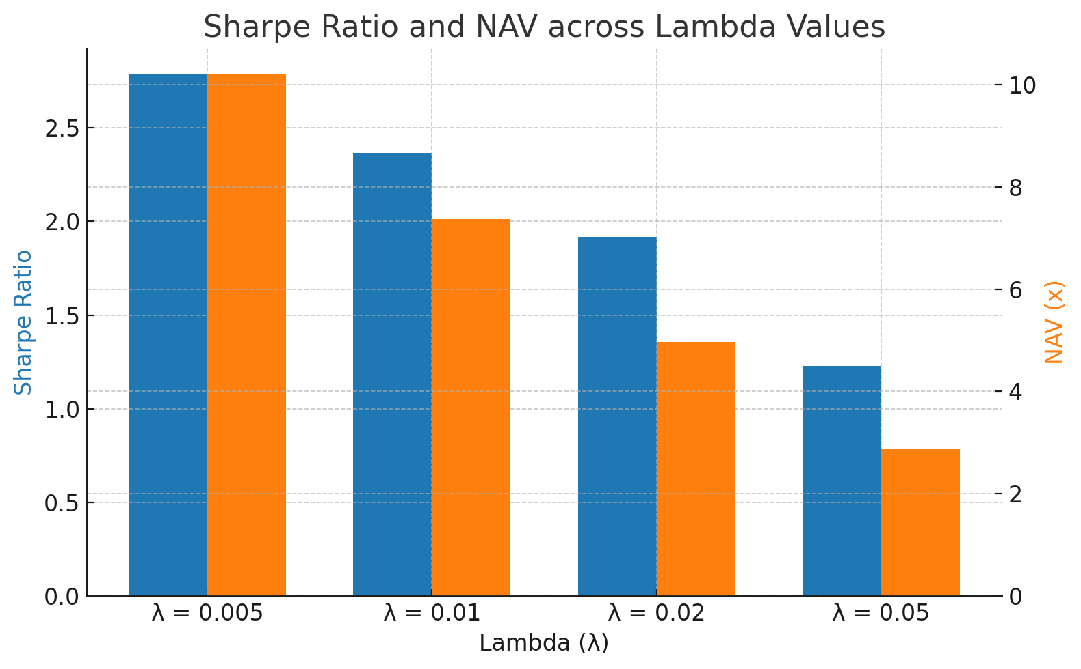
Lambda Sensitivity Analysis
Transaction cost penalty lambda varied: 0.005, 0.01, 0.02, 0.05
Observations:
Higher lambda: less turnover, lower Sharpe
Optimal trade-off at lambda = 0.01

Slide 14
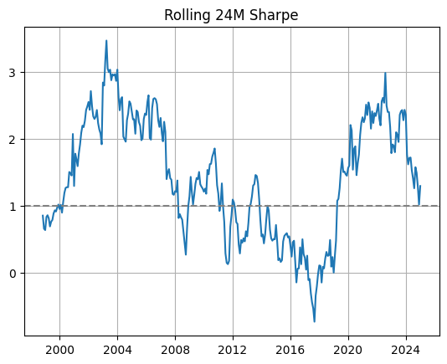
Rolling Sharpe Ratio
24-month rolling Sharpe captures strategy consistency
Maintains strong performance through macro volatility

Slide 15
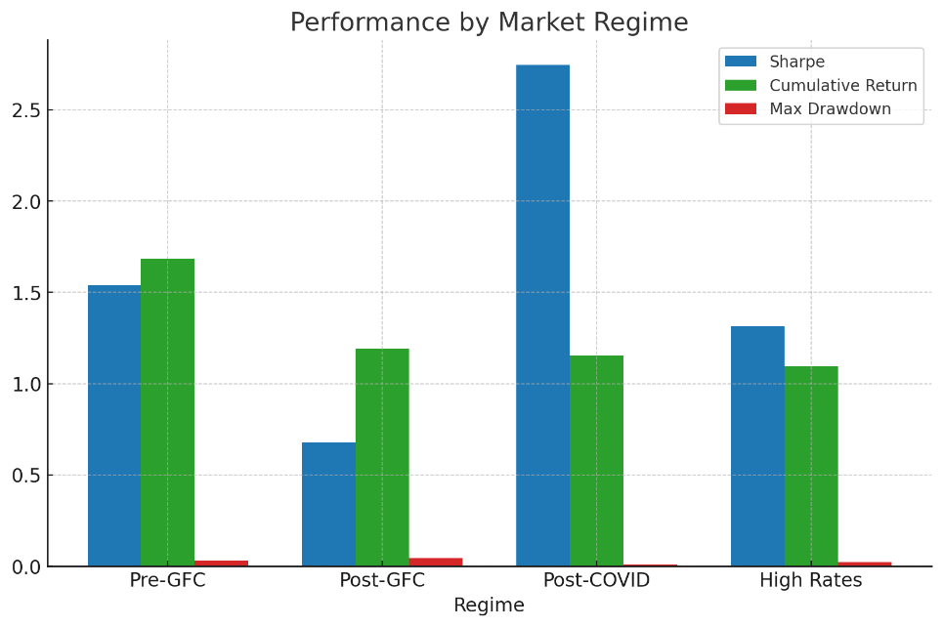
Performance by Market Regimes
Evaluated performance in 4 macro periods:
Pre-GFC (1996–2007)
Post-GFC (2009–2019)
Post-COVID (2020–2021)
High Rates (2022–2024)
Metrics: Sharpe, Cumulative Return, Max Drawdown
 | Sharpe | Cumulative Return | Max Drawdown
Pre-GFC | 1.538496 | 1.684364 | 0.030741
Post-GFC | 0.677654 | 1.191640 | 0.044489
Post-COVID | 2.744731 | 1.154922 | 0.008697
High Rates | 1.314647 | 1.096379 | 0.023588

Slide 16
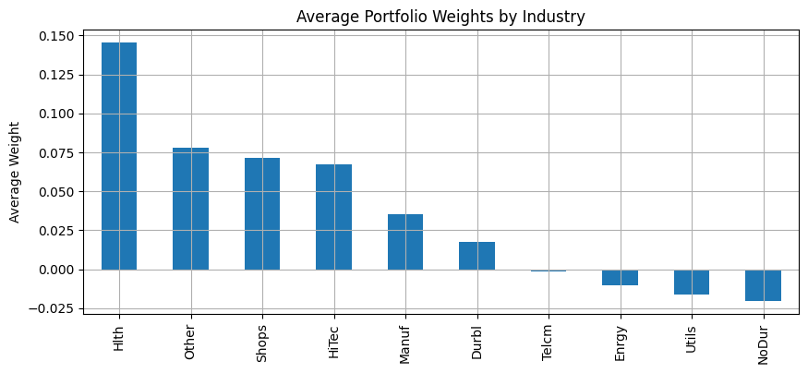
Average Portfolio Weights
Averaged weights show preference for sectors like Tech, Health
Reflects stability and long-run alpha persistence

Slide 17
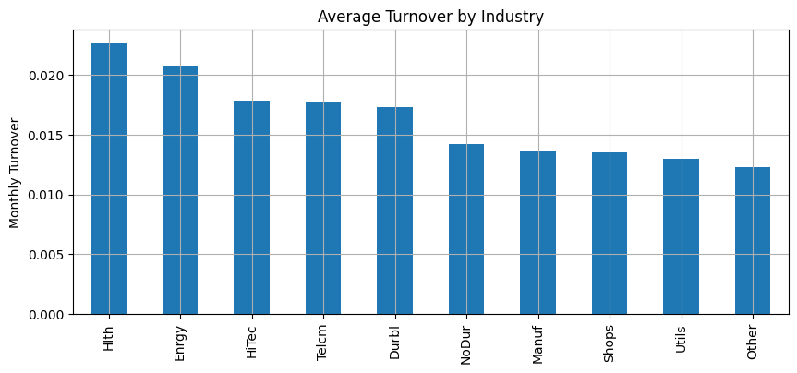
Turnover by Sector
High-turnover sectors: Energy, Telecom (more volatile signals)
Low-turnover: Utilities, Health (more persistent alpha)

Slide 18
Key Insights
Dynamic strategies effectively incorporate real-world trading costs and signal decay, leading to more implementable solutions.
Signals with slower mean-reversion (low phi) have higher value; the strategy inherently favors them through scaling.
Partial rebalancing toward a forward-looking aim portfolio reduces churn while preserving alpha exposure.
Compared to static approaches, dynamic trading results in smoother transitions and lower volatility of weights.
Rolling evaluations show consistent Sharpe ratios and robust performance across macro regimes.

Slide 19
Reinforcement Learning Extension – PPO Setup
MDP Environment (PortfolioEnv)
State: last 60 months of factor history + previous portfolio weights
Action: continuous vector of new portfolio weights (∑wᵢ = 1, wᵢ ≥ 0)
Reward: net monthly P&L = wᵀr − λ‖w − w_prev‖₁
Step: advance one month, apply transaction cost, observe next state
Hyperparameters
Window = 60 months, λ_tc = 1% per turnover
Discount γ = 0.99 (long-horizon wealth maximization)

Slide 20
PPO Agent & Training
Algorithm: Proximal Policy Optimization (MlpPolicy)
Clip range = 0.2, entropy_coef = 0.0
Learning rate = 1e-4, epochs = 10, GAE λ = 0.9
Batch size = 64, n_steps = 2048
Training Regime
In-sample: 1963 to midpoint of data
Clip range = 0.2, entropy_coef = 0.0
Learning rate = 1e-4, epochs = 10, GAE λ = 0.9
Batch size = 64, n_steps = 2048
Timesteps: 500K environment steps
Monitoring: convergence via episode reward mean

Slide 21
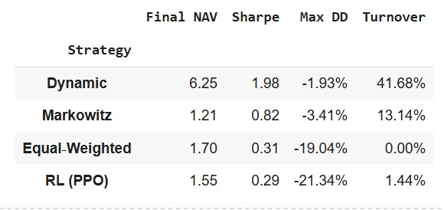
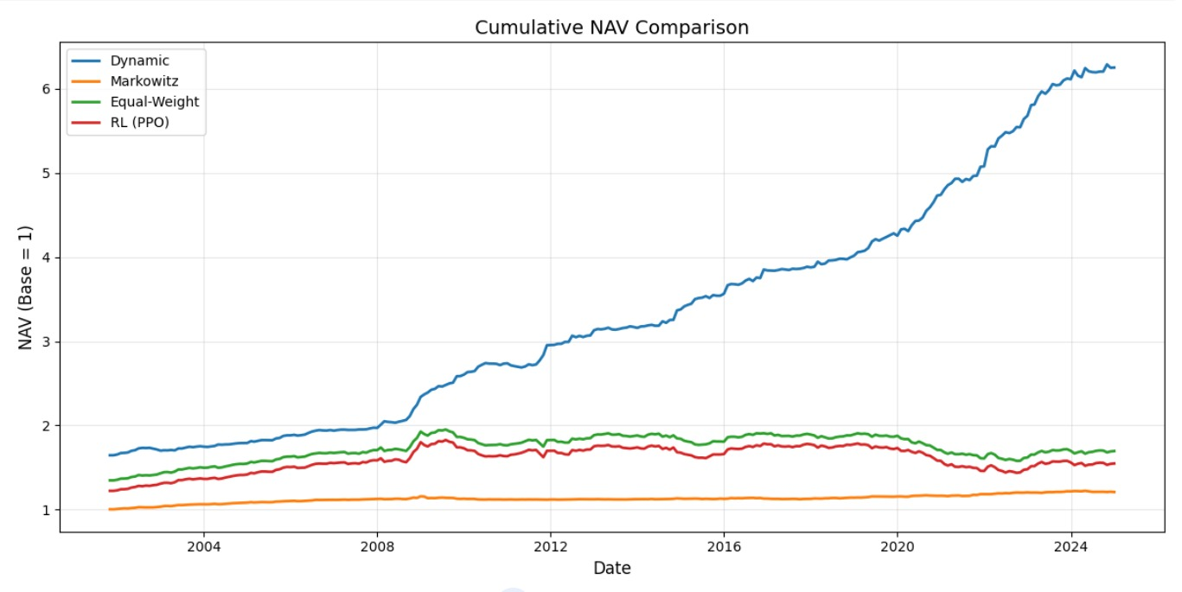
PPO Performance & Comparison

Slide 22
Conclusion
The Gârleanu & Pedersen model provides a practical, closed-form solution to balance alpha capture and transaction costs.
Our dynamic trading strategy demonstrated strong outperformance against static and equal-weight benchmarks.
Reinforcement Learning (PPO) offered a flexible learning-based alternative, though it underperformed the analytical dynamic approach in our setup.
Results highlight that while RL introduces adaptability, traditional model-driven methods still hold a significant edge in structured, factor-driven environments.
The project establishes a comprehensive framework to compare static, dynamic, and learning-based portfolio strategies under realistic constraints.

Slide 23

THANK YOU

